Slide 1

New trend to make everything engaging

Slide 2
Definition Use of game thinking and game mechanics in NON-GAME contents to engage users to a more interactive world.
Domains
Education User Engagement
Physical Exercise Return on Investment
Data Quality Timeliness

Slide 3


TECHNIQUES
LEVERAGE ON PEOPLE’S NATURAL DESIRE FOR
COMPETITION
ACHIEVEMENT
STATUS
SELF EXPRESSION
ALTRUISM

Slide 4



COMMERCIAL APPLICATIONS

Slide 5
Rules to Gamify
RULE 1 : You’re not making a game
RULE 2 : Knowing the reasons why you wanted to gamify
RULE 3 : Knowing what you want to achieve
RULE 4 : They don’t acquire customers , they retain
RULE 5 : Games are not just about competitions
RULE 6 : Losers Leave
RULE 7 : It produces a steady growth not an immediate impact

Slide 6
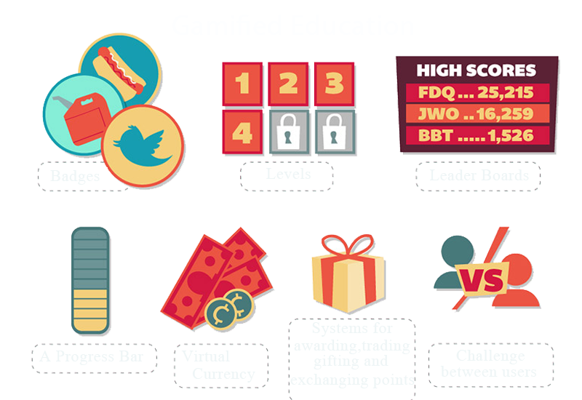

Slide 7

GAMIFIED EDUCATION SYSTEM

Slide 8
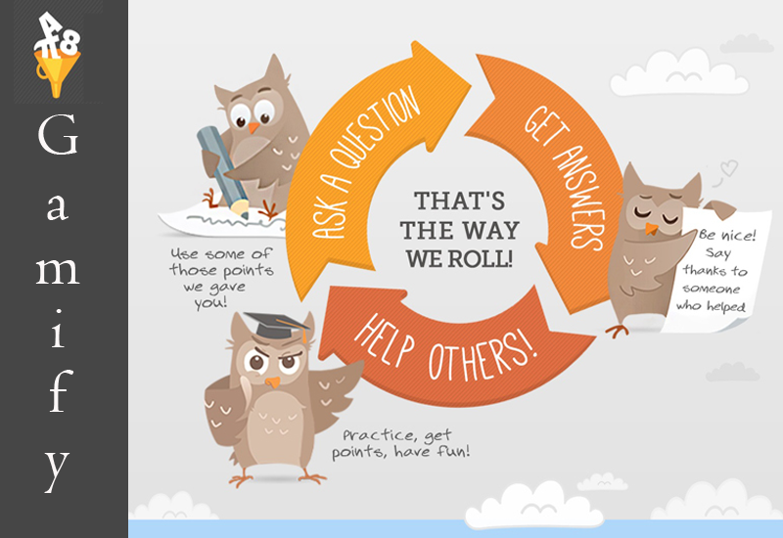

Slide 9
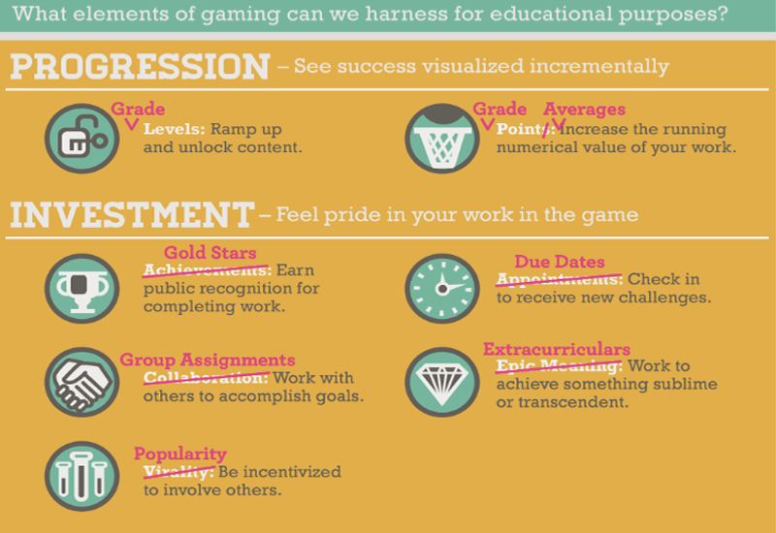

Slide 10
